Slide 1

Technical Status Presentation
Mario Abdelsayed
Michael Mason
Sam Bishop
Adesuen Idowu
Brad Henderson

Slide 2
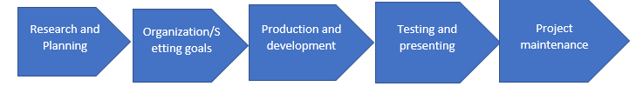

2.0 Project Organization
Process model
Staff

Slide 3
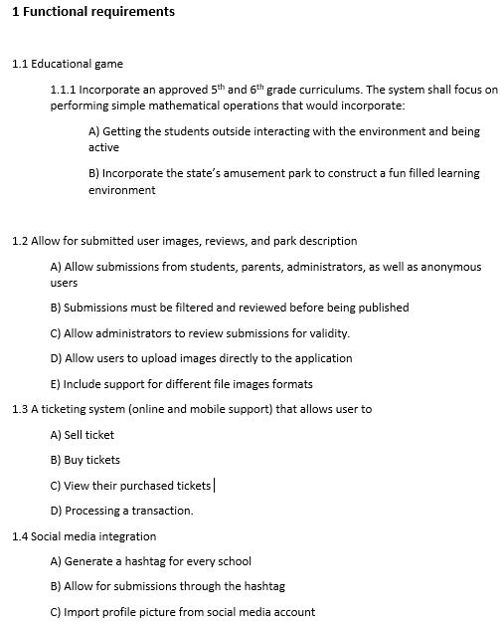
Requirements

Slide 4
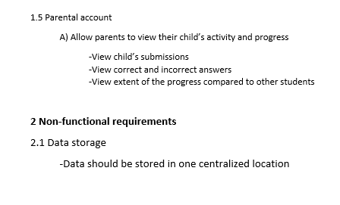
Requirements

Slide 5
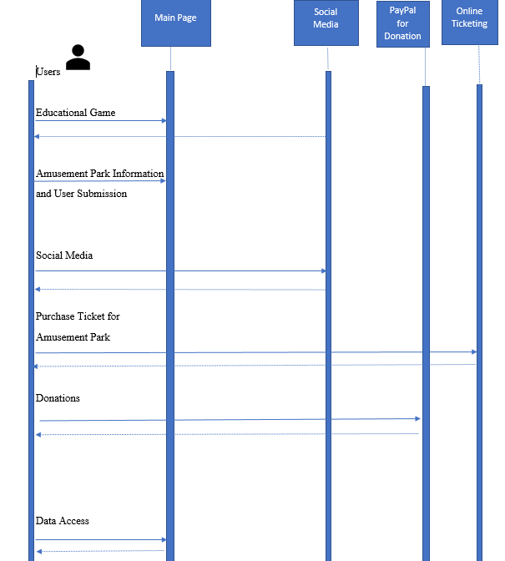
Sequence Diagram

Slide 6
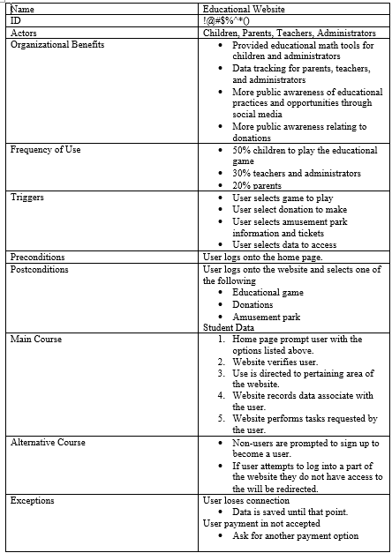
Use Case

Slide 7
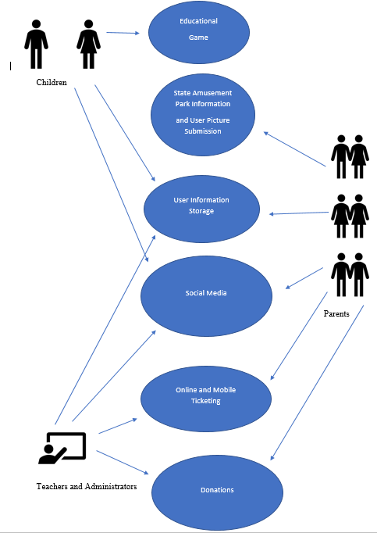
Use Case

Slide 8
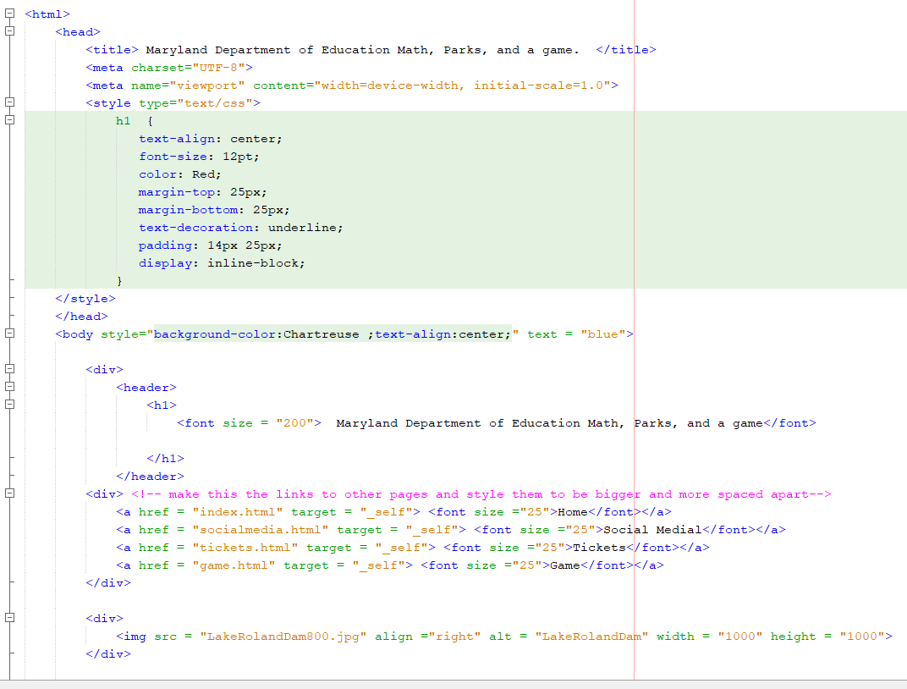
Code

Slide 9
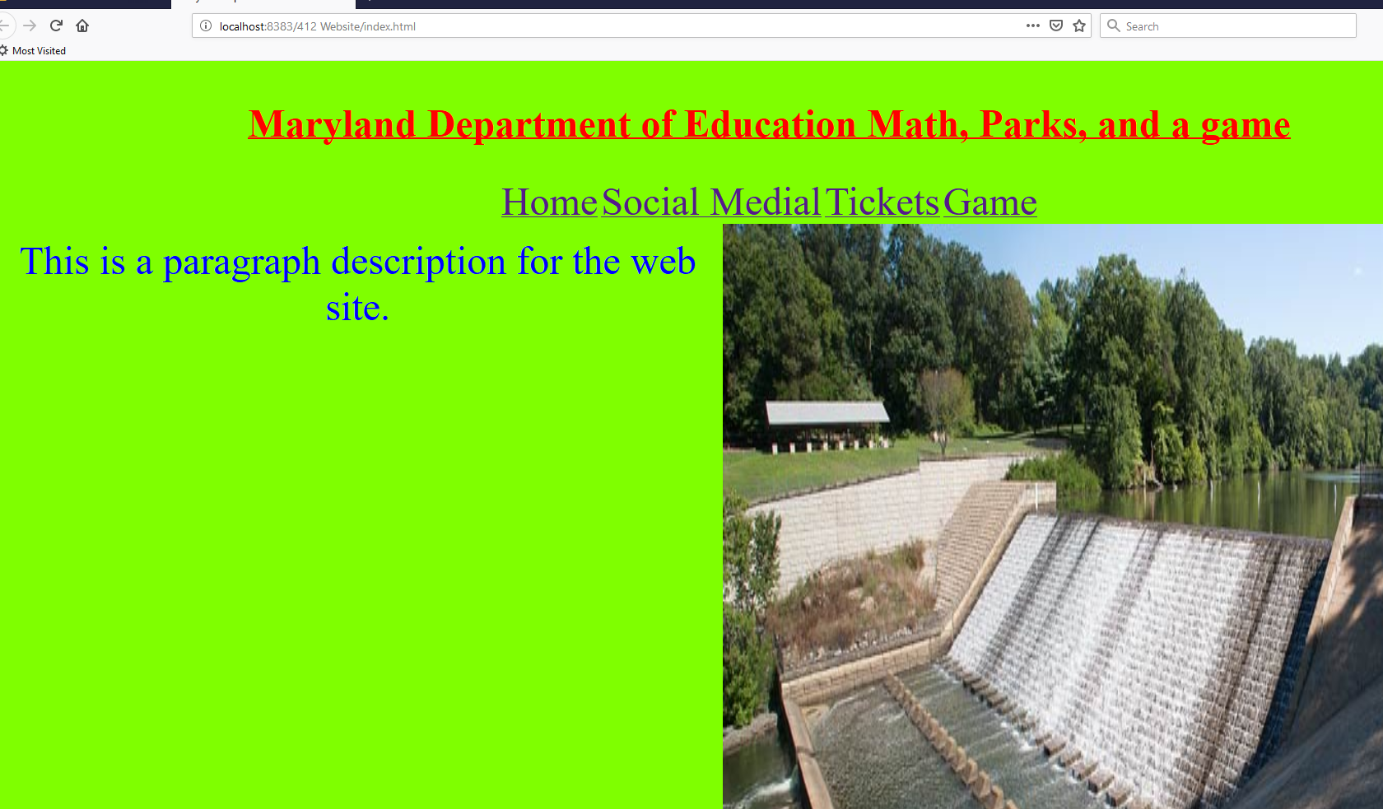
Web Site

Slide 10
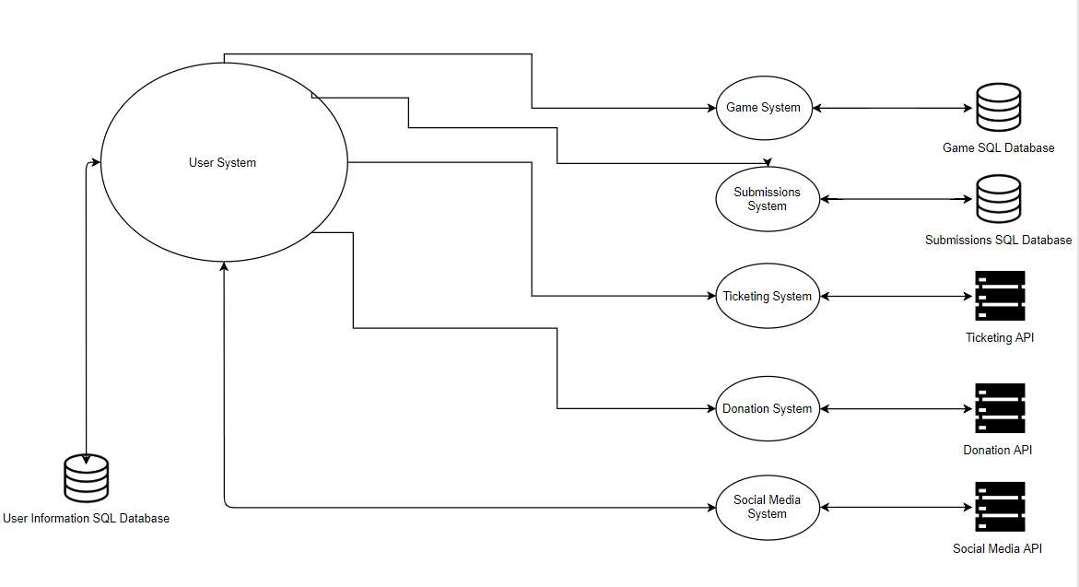
HLA

Slide 11
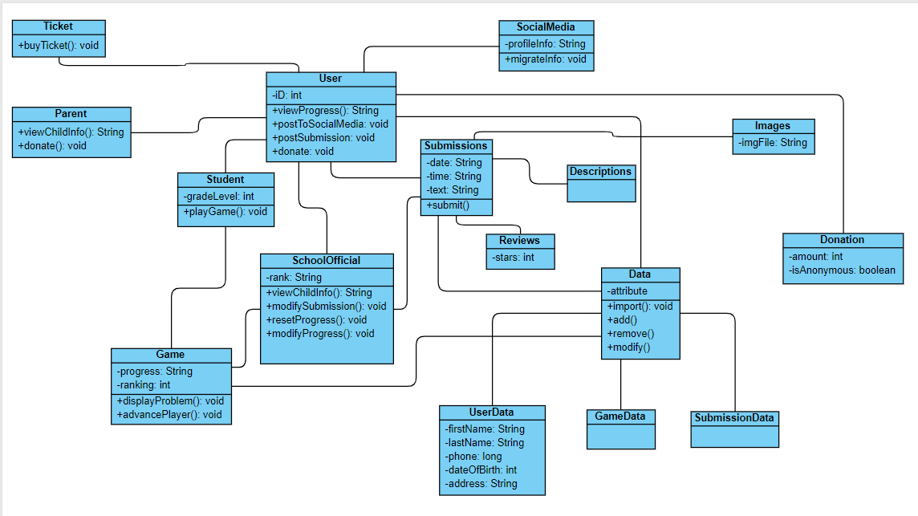
Class Diagram

Slide 12
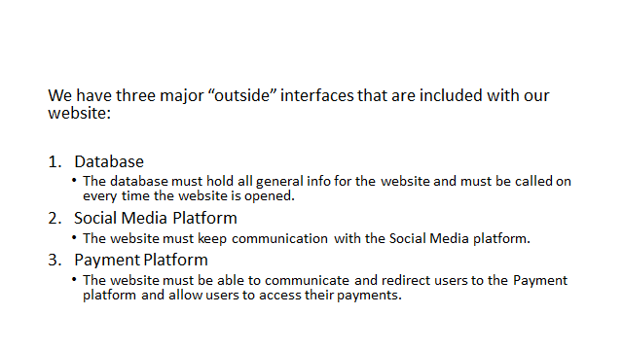
Interface Specifications

Slide 13

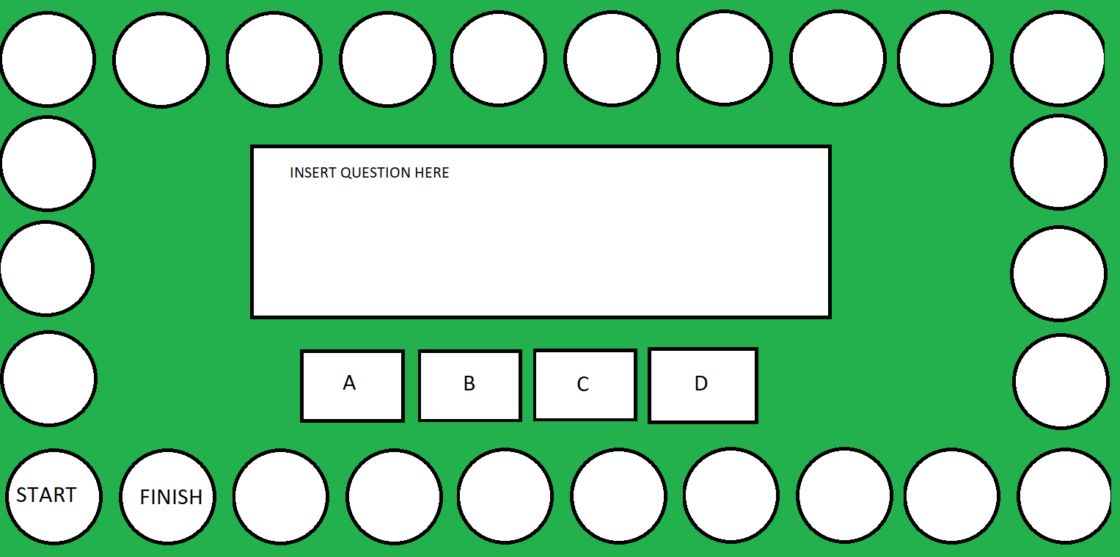
The Game will have students move clockwise around the board, answering math questions to progress

Slide 14
Code
Coded in java
Utilizes a swing timer technique to create animation
Will be an applet to integrate with the website

